Slide 1
Macro Solar and Macro Wind
World wide use of Renewable energy.
Items removed due to confidentiality agreement.

Slide 2
Comparing Micro Wind power to Micro Solar. (Based upon Macro prices.)
Macro wind is 4 to 7 cents/kWh. That comes out to .004 to .007 cents for a watt hour of power.
Micro wind will cost 0.000004 to .000007 cents per mWh. (milli-watt hour of power).
Macro Sun is 20 to 50 cents/kWh. That comes out to .02 to .05 cents for watt hour.
Micro Sun is 0.00002 to 0.00005 cents per mWh.

Slide 3
Relative cost for kWh
The oil industry uses price per barrel as its unit of price measurement. The solar energy industry typically uses price per Watt Peak (Wpeak/solar) as its primary unit of measurement.
A solar panel is rated to produce peak wattage under peak light conditions. The prices for high power band solar modules has dropped from around $27/Wp in 1982 to around $4/Wp today. (A 1 watt panel will cost $4. A 1Kwatt panel will cost in excess of $4000.) Prices higher and lower than this are usually dependent upon the size of the installation.
Guideline electricity generation costs today (cents/kWh)
Combined cycle gas turbine | 3-5
Wind | 4-7
Biomass gasification | 7-9
Remote diesel generation | 20-40
Solar PV central station | 20-30
Solar PV distributed | 20-50

Slide 4
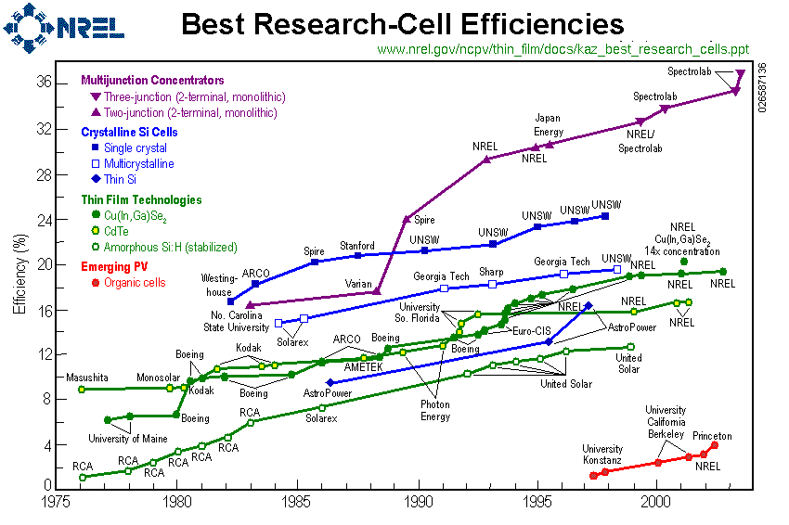
Solar Blue Sky

Slide 5
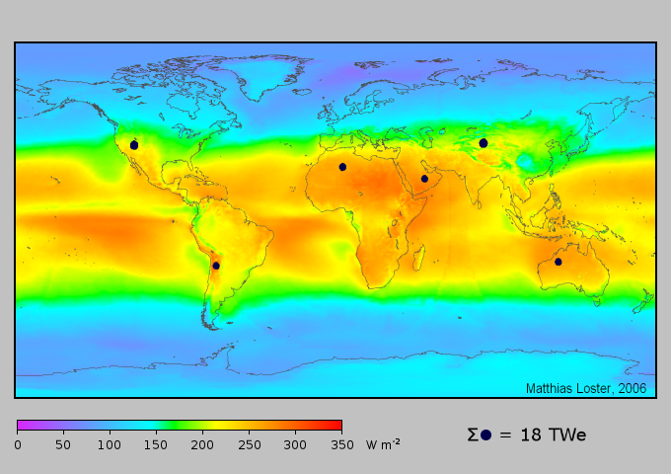
Where Solar Pays

Slide 6
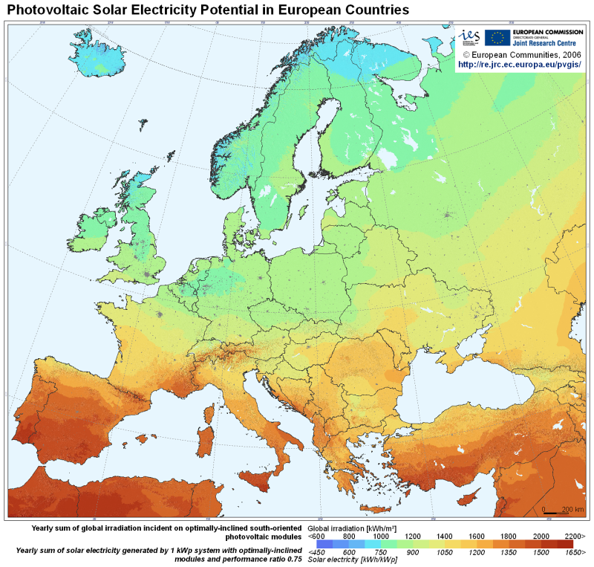
Solar Europe

Slide 7
Macro Solar
Macro Solar works in the Sun belt regions of the world.

Slide 8
Solar cells and energy payback
In the 1990s, when silicon cells were twice as thick, efficiencies of 30% lower than today and lifetimes shorter, it may well have cost more energy to make a cell than it could generate in a lifetime.
The energy payback time of a modern photovoltaic module is anywhere from 1 to 20 years (usually under five)depending on the type and where it is used
This means solar cells can be net energy producers, meaning they generate more energy over their lifetime than the energy expended in producing them.

Slide 9
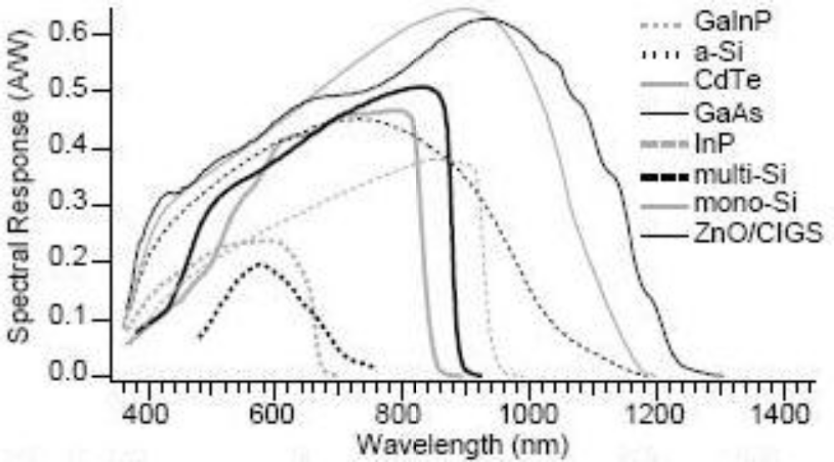

Solar Cell Responsivity
1 watt at 555 nm = 683.0 lumens
These spectrum response curves are from a chart in a report published by NREL: "Solar Cell Spectral Response Measurement Errors Related to Spectral Band Width and Chopped Light Waveform"
They represent the most useful region of the electromagnetic spectrum for each type of semiconductor compound. Many modern cells are multi-layer structures that combine multiple compounds to harness a much larger portion of the available energy than would be possible with a single type of solar cell.
These spectrum response curves are from a chart in a report published by NREL: "Solar Cell Spectral Response Measurement Errors Related to Spectral Band Width and Chopped Light Waveform"
They represent the most useful region of the electromagnetic spectrum for each type of semiconductor compound. Many modern cells are multi-layer structures that combine multiple compounds to harness a much larger portion of the available energy than would be possible with a single type of solar cell.

Slide 10
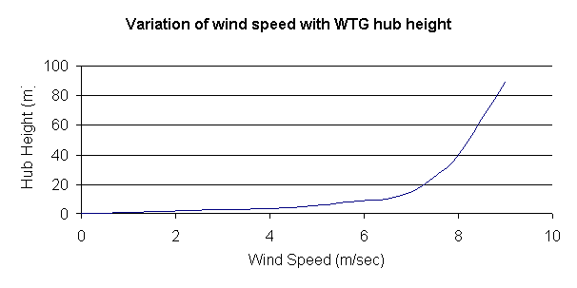
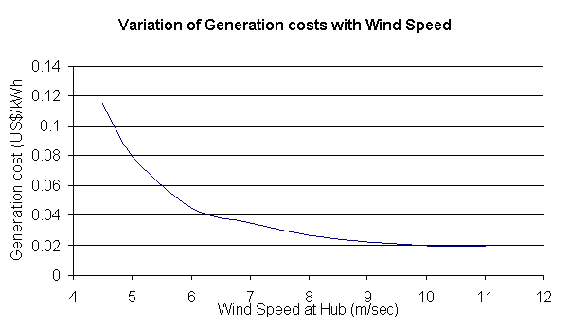
Wind Generation Cost

Slide 11
Where Macro Wind Pays
Macro Wind is a Blue technology. See wind maps.
Works best in coastal areas and in

Slide 12
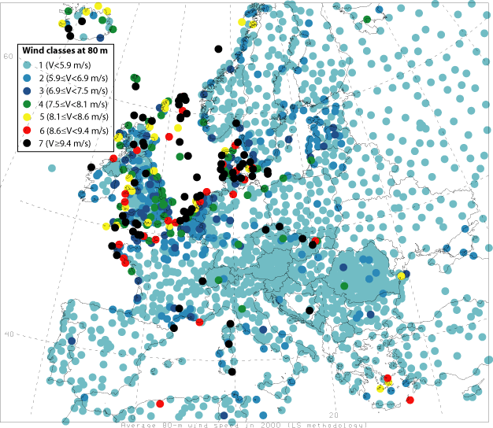
Wind Europe

Slide 13
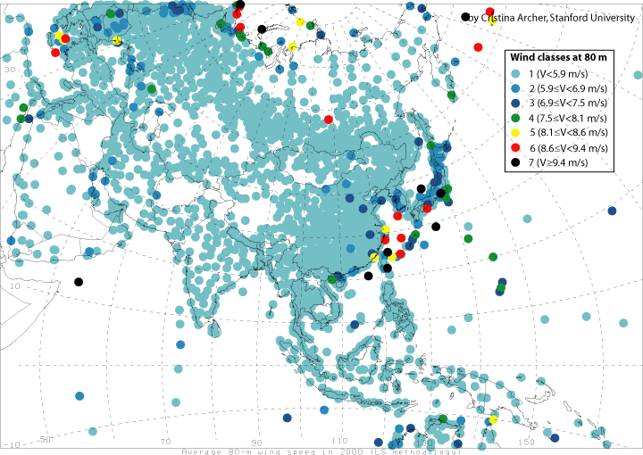
Wind Asia

Slide 14
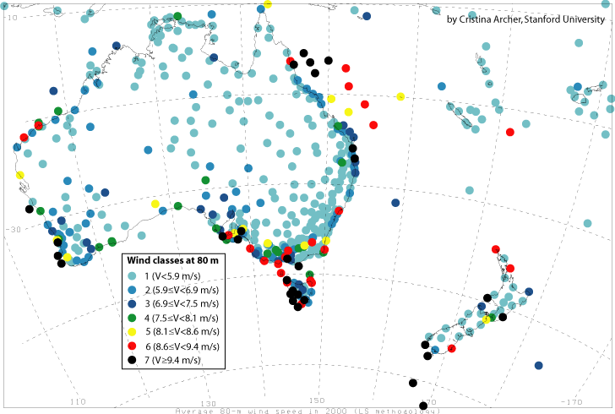
Wind Australia

Slide 15
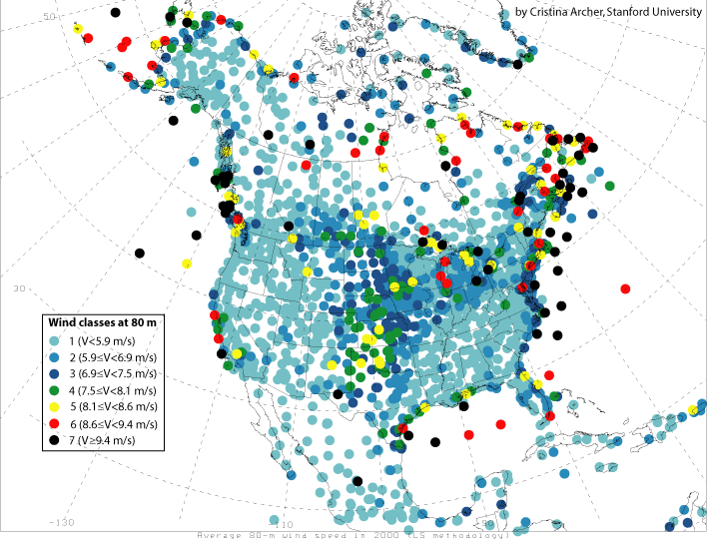
Wind North America

Slide 16
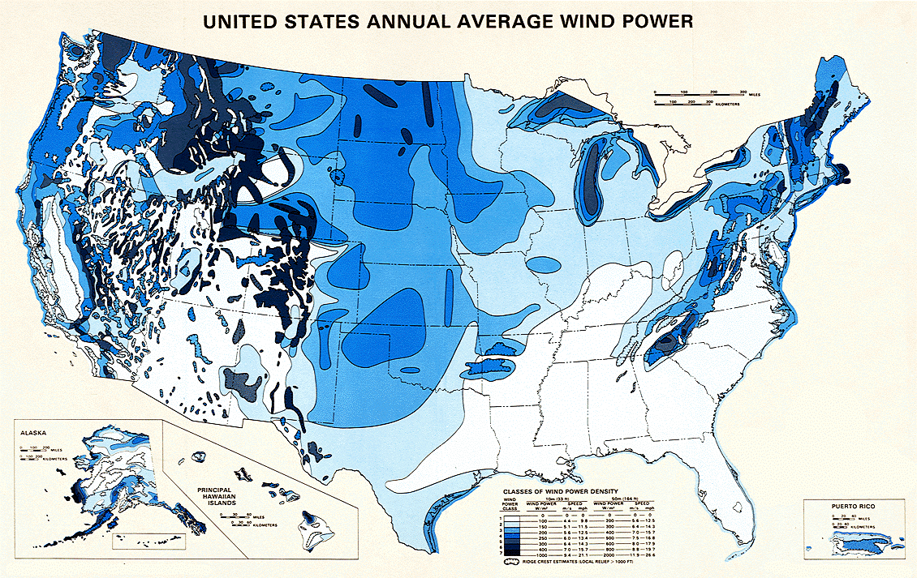
US Average Wind Power

Slide 17
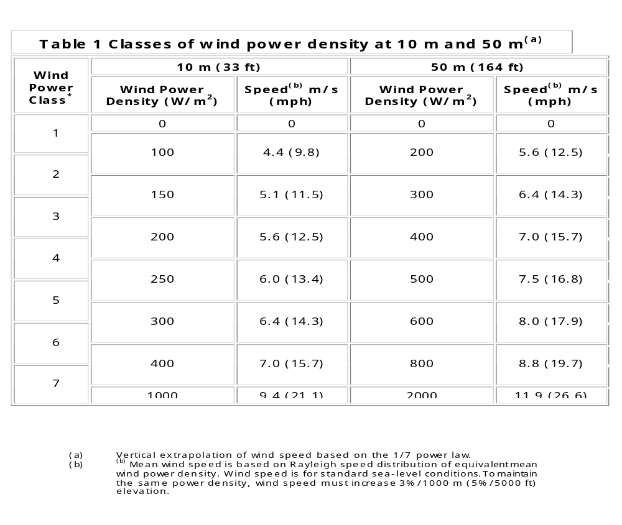
US DOE Wind Classes

Slide 18
Basic Wind Conversion Formulas
English units
Metric units
w = 0.0052 A v³
w = 0.625 A v³
where w is power in watts, and A is the cross-sectional area in square feet swept out by the wind turbine blades, and v is the wind speed in miles per hour.
where w is power in watts, and A is the cross-sectional area in square meters swept out by the wind turbine blades, and v is the wind speed in meters per second.

Slide 19
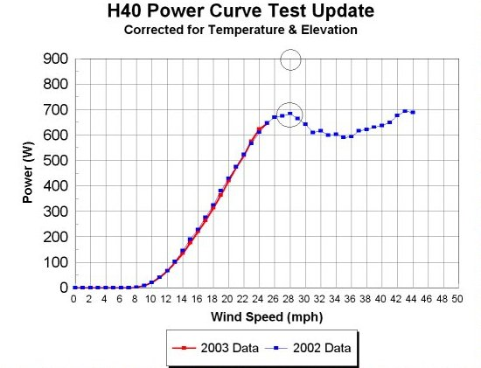
Small Wind Turbine Comparison

Slide 20
Micro Wind
Micro Wind plays in areas with low wind velocity.

Slide 21
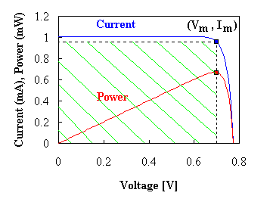
Power Density of Solar
The p-n diode solar cell
Solar cells are typically illuminated with sunlight and are intended to convert the solar energy into electrical energy. The solar energy is in the form of electromagnetic radiation, more specifically "black-body" radiation, due to the fact that the sun has a temperature of 5800 K. The radiation spectrum has a peak at 0.8 eV, while a significant part of the spectrum is in the visible part of the spectrum (400 - 700 nm). The power density is approximately 100 mW/cm².
Only part of the solar spectrum actually makes it to the earth's surface because of scattering and absorption in the earth's atmosphere, while the angle with respect to a normal to the surface - and therefore also the power density - depends on the time of the day, the time of the year and the latitude of a specific location.
Of the solar light which does reach a solar cell only photons with an energy larger than the energy bandgap of the semiconductor generate electron-hole pairs. In addition one finds that the voltage across the solar cell at the point where it delivers its maximum power is less than the bandgap energy in electron volt. The overall power conversion efficiency of single crystalline solar cells ranges from 10 to 30% yielding 10 to 30 mW/cm².

Slide 22
Link and Resources.
http://www.nooutage.com/windmaps.htm#US%20DOE%20Wind%20Classes
http://www.wind-works.org/articles/small_turbines.html
http://www.stanford.edu/group/efmh/winds/global_winds.html
http://homepages.inf.ed.ac.uk/rbf/CVonline/LOCAL_COPIES/RYER/index.html
http://mapserve2.nrel.gov/website/PVWATTSLITE/viewer.htm
http://www.udel.edu/igert/pvcdrom/index.html
http://ece-www.colorado.edu/~bart/book/solar.htm
http://www.ucsusa.org/assets/images/renewable_energy/NREL-wind-map-large.jpg
http://www.energy.iastate.edu/renewable/wind/wem/wem-08_power.html
http://www.geocities.com/pemnq/windscan.html

